Slide 1
DATA DRIVEN STOCK ANALYSIS
MENU
ANALYSIS
CONTACT
DATA ANALYSIS
Presented by Shanchai Kumar S

Slide 2
Project Outline :
01
Problem statement
02
Data Preparation
03
Data analysis
04
Data visualization
05
Live demo

Slide 3
The Problem
The Stock Performance Dashboard aims to provide a comprehensive visualization and analysis of the Nifty 50 stocks' performance over the past year.
The project will analyze daily stock data, including open, close, high, low, and volume values. Clean and process the data, generate key performance insights, and visualize the top-performing stocks in terms of price changes, as well as average stock metrics.
The solution will offer interactive dashboards using Streamlit and Power BI to help Investors, analysts, and enthusiasts make informed decisions based on the stock performance trends.

Slide 4
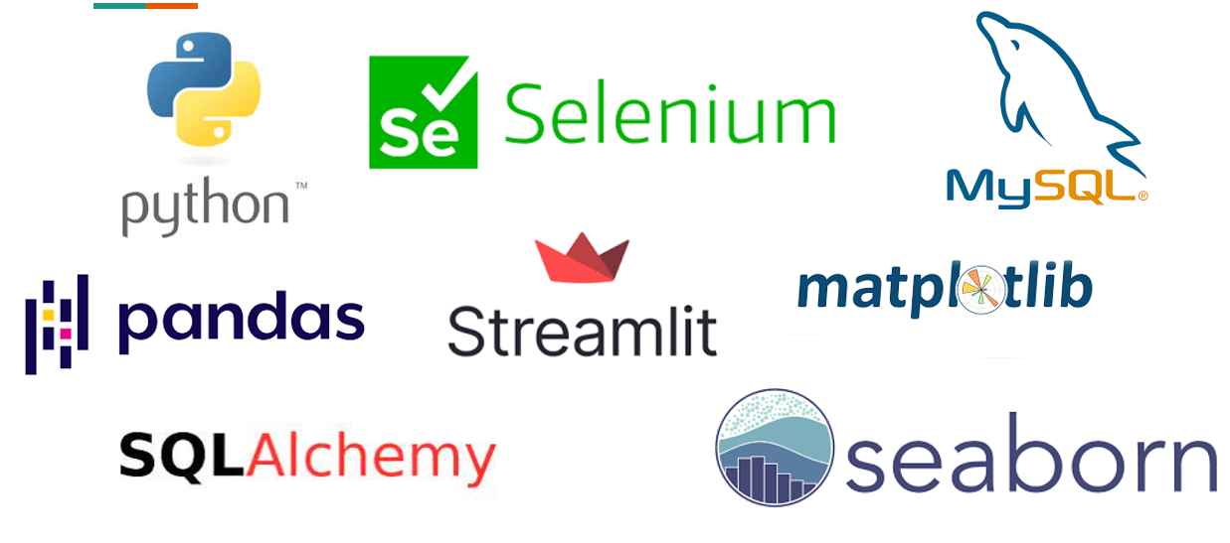

Technologies used

Slide 5
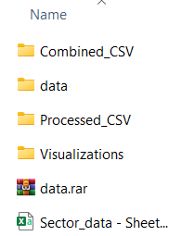
Data prepartion
The project involves extracting stock data formatted in YAML from different monthly folders. Each entry contains crucial stock information, which will later be converted into CSV for analysis.
After extraction, data will be transformed into CSV format. This step ensures that the stock data is organized and accessible for analysis, enabling better manipulation and processing in Python and Power BI.
Once data is in CSV format, it is organized by stock symbols. This results in creating multiple CSV files, one for each stock symbol, which simplifies analysis and visualization.

Slide 6
Data analysis
This section presents the analysis that ranks stocks based on performance metrics such as yearly returns and correlation between stocks etc.,
Volatility analysis
Cumulative returns over time
Sector wise performance
Stock price correlation
Top 5 Gainers and Losers (Month wise)

Slide 7
Volatility analysis
Objective: Visualize the volatility of each stock over the past year by calculating the standard deviation of daily returns.
Reason: Volatility gives insight into how much the price fluctuates, which is valuable for risk assessment. Higher volatility often indicates more risk, while lower volatility indicates a more stable stock.
Metrics:
Calculate daily returns for each stock: (Close Price - Previous Close Price) / Previous Close Price.
Compute the standard deviation of daily returns for each stock to measure volatility.
Plot a bar chart showing the volatility of the top 10 most volatile stocks over the year.

Slide 8
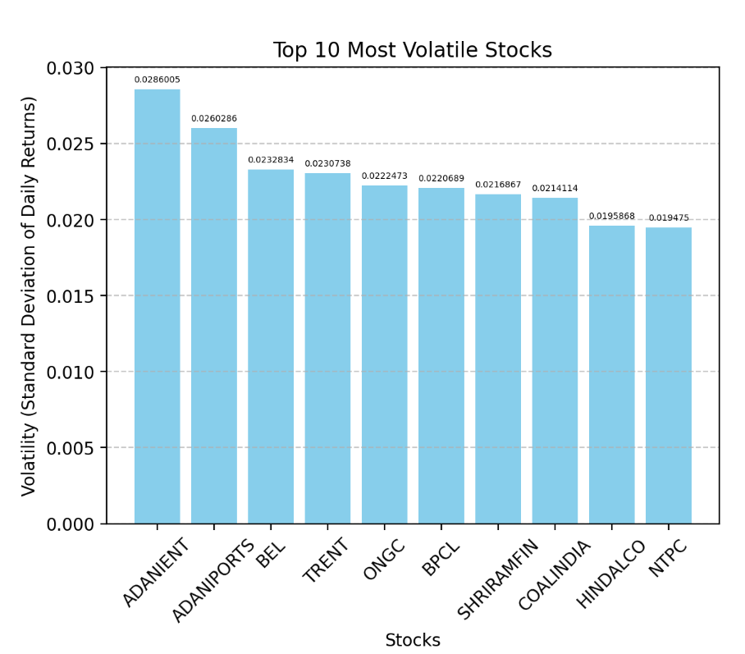
Visualization for Volatility analysis in streamlit

Slide 9
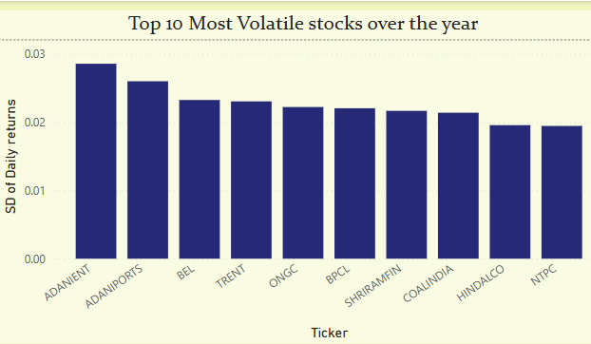
Visualization for Volatility analysis in Power Bi

Slide 10
Cumulative return over time
Objective: Show the cumulative return of each stock from the beginning of the year to the end
Reason: The cumulative return is an important metric to visualize overall performance and growth over time. This helps users compare how different stocks performed relative to each other.
Metrics:
For each stock, calculate the cumulative return by applying a running total of daily returns.
Plot a line chart for the top 5 performing stocks (based on cumulative return) over the course of the year.

Slide 11
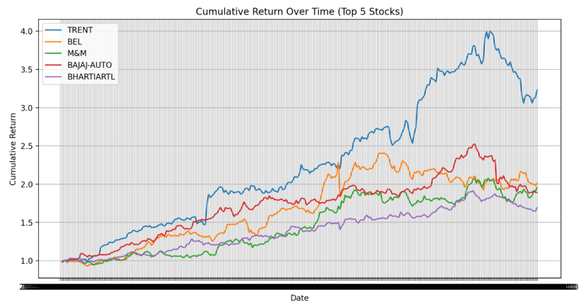
Visualization for cumulative return over time in streamlit

Slide 12
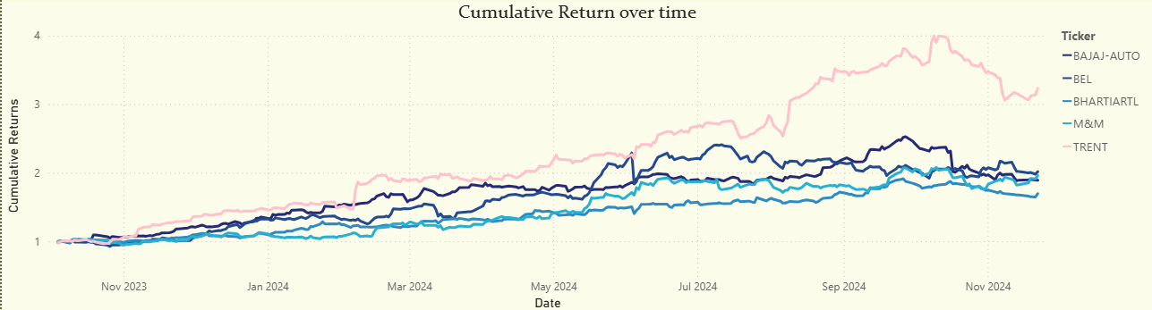
Visualization for cumulative return over time in Power bi

Slide 13
Sector wise performance
Objective: Provide a breakdown of stock performance by sector (sector data shared as csv).
Reason: Investors and analysts often look at sector performance to gauge market sentiment in specific industries (e.g., IT, Financials, Energy, etc.).
Metrics:
Classify each stock by its sector (this can be done by adding a separate dataset or manually mapping sectors to stocks).
Calculate the average yearly return for each sector.
Plot a bar chart showing the average performance for each sector.

Slide 14
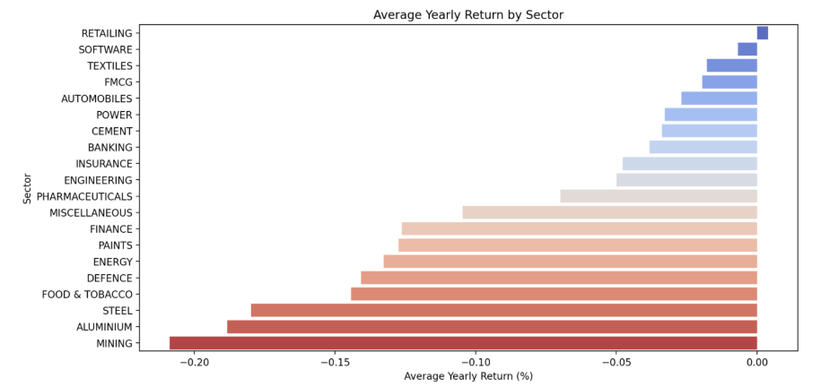
Visualization for sector wise performance in streamlit

Slide 15
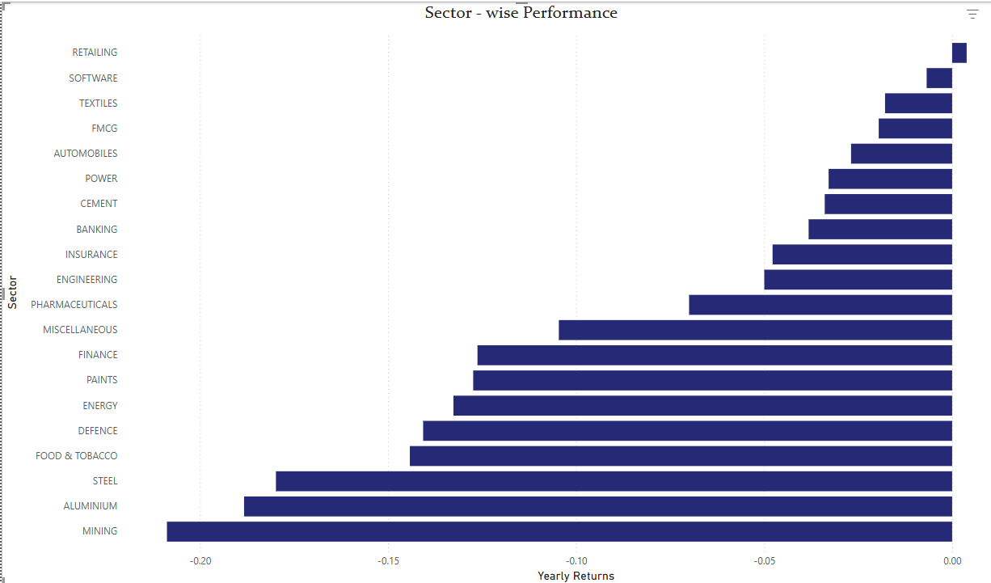
Visualization for sector wise performance in Power bi

Slide 16
Stock price correlation
Objective: Visualize the correlation between the stock prices of different companies.
Reason: This analysis is valuable to understand if certain stocks tend to move in tandem (e.g., correlated with market trends or sector performance).
Metrics:
Calculate the correlation coefficient between the closing percentage of different stocks. For this, use the pandas.DataFrame.corr() method.
Create a correlation matrix to identify how stocks are related to each other.
Plot a heatmap of the correlation matrix to visualize these relationships.

Slide 17
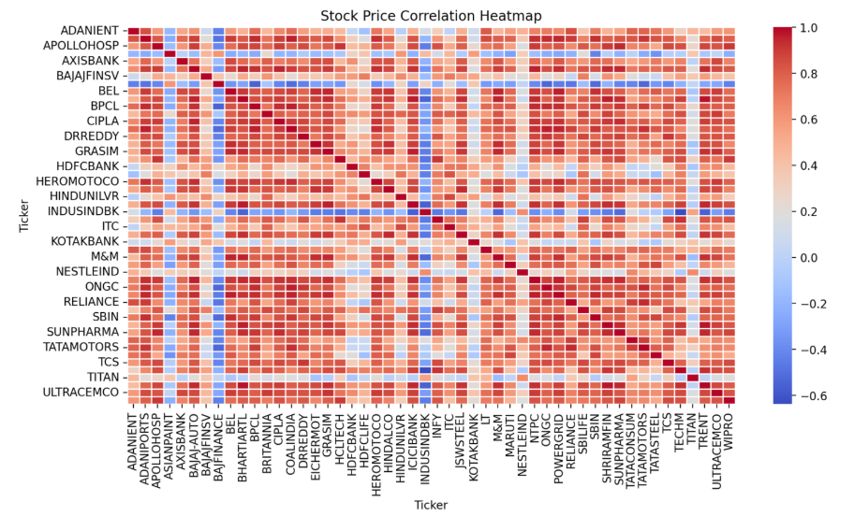
Visualization for stock price correlation in streamlit

Slide 18
Top 5 Gainers and losers (month wise)
Objective: Provide monthly breakdowns of the top-performing and worst-performing stocks.
Reason: This analysis will allow users to observe more granular trends and understand which stocks are gaining or losing momentum on a monthly basis.
Metrics:
Group the stock data by month and calculate the monthly return for each stock.
For each month, identify the top 5 gainers and top 5 losers based on percentage change.
Create a dashboard-style visualization with 5 charts showing top gainers and losers for each month (12 months total).

Slide 19
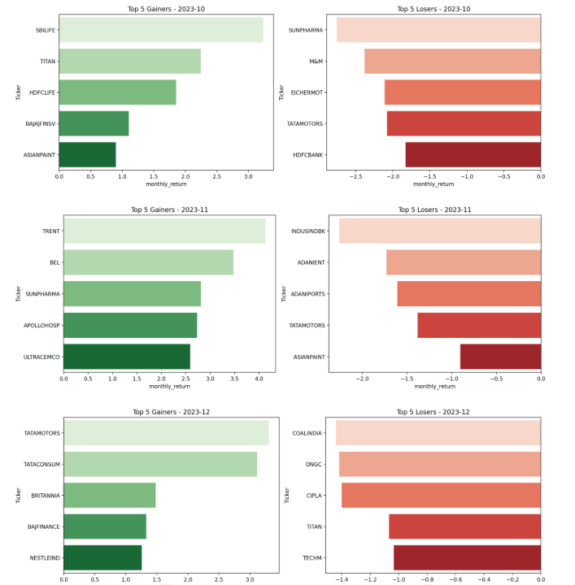
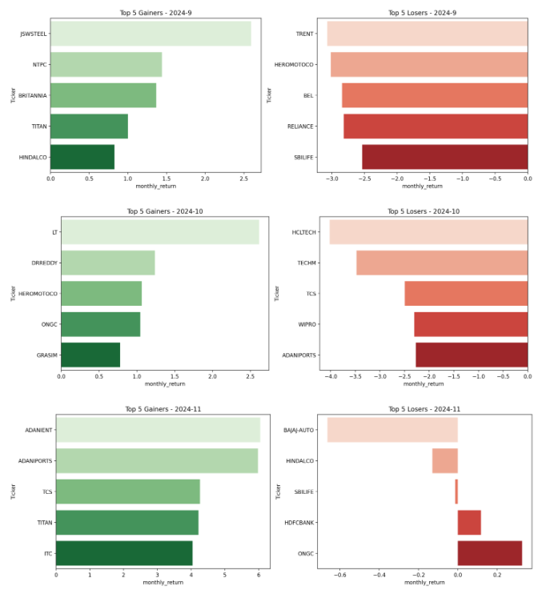
Visualization for Top 5 gainers & losers in streamlit

Slide 20
Live Demo
MENU
ANALYSIS
CONTACT
DATA ANALYSIS

